Slide 1

Master Thesis Presentation
Department of Electrical Engineering and Computer Science
Siegen University
Chair of Interconnected Automation Systems
Gripping Strategy and Parameter
Determination Using the PPR-SC
Model for Modular Battery
Assembly Automation
First Supervisor: Dr.-Ing. Thomas Schulte.
Second Supervisor: Mr. Andreas Gaugenrieder, M.Eng.
Presented by: Milton Sebaastin Clement Sepasthiyammal

Slide 2
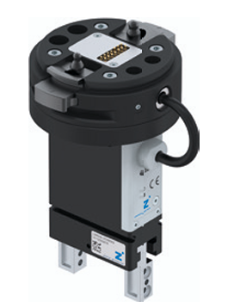
Motivation & Problem Statement
Battery assembly and disassembly requires precise, repeatable manipulation.
HMLV Production: High-Mix-Low-Volume manufacturing requires rapid robot reconfiguration.
Manual reconfigurations are not flexible, time consuming and prone to errors and often non-scalable.
Gap: Current solutions lack systematic gripping parameter determination.
Parallel Jaw Gripper

Slide 3
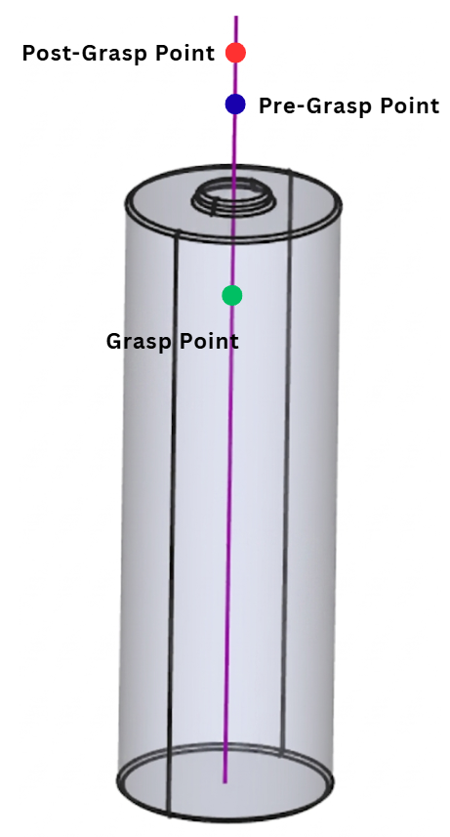
Objective
Develop an automated pipeline for battery assembly and disassembly.
Estimate optimal gripping parameters such as grip points, offsets, and required gripping force from CAD.
Export a structured JSON (JavaScript Object Notation) for robot control and simulation
Validate the workflow and parameters through simulation.

Slide 4
Scope
This thesis does not extend to complex multi-finger dexterous manipulation
Real-time computer vision-based grasp detection is not considered; instead, the emphasis lies on geometry-driven parameter estimation from digital models.
Deformable object handling, soft robotic grippers, and real-time sensor-based adaptive grasping are beyond the scope of this study.

Slide 5
System Architecture
3D CAD Object Model
Geometry Extraction (FreeCAD)
Data Representation - JSON
Physics Simulation (MuJoCo)
Control Script
Pick and Place Validation
The System Architecture depicts a 6-stage workflow connecting the 3D model to robot simulation.
Data Flow Layer
Decision Layer

Slide 6
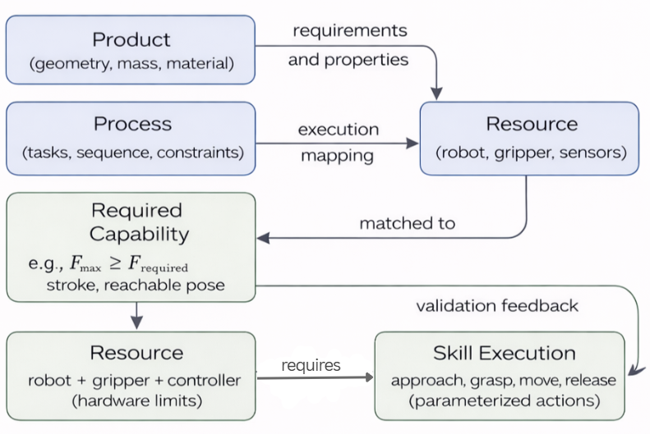
PPR-SC Model
The PPR-SC [Product Process Resource – Skill Capabilities] model concept involves the separation of Product, Process and Resource data. The Skill and Capability block defines what the resource can do and how it executes a task respectively.

Slide 7
Data Requirements
In the proposed framework, gripping parameters are derived from a combination of geometric, physical, process-related, and resource-related data.
These data categories correspond to the Product–Process–Resource modelling and serve as the primary inputs for the gripping parameter estimation.
Data Requirements
Product Data
Process Data
Resource Data

Slide 8
Physical Property Extraction - Product
Product
Physical Properties
Mass
Center of Mass
Material Properties
Material of the Object
Geometry
Surface Friction
The Product properties are essential for determining the forces required for stable manipulation.
These properties influence the mechanical interaction between the gripper and the object.

Slide 9
Pick and Place Parameters - Process
Process
Grasp pose
Lift pose
Pre-Pick pose
Place pose
Process parameters define how the object should be manipulated within the manufacturing workflow and specify constraints related to the pick-and-place task.

Slide 10
Gripper Parameters - Resource
Resource
Gripper Stroke
Gripper Geometry
Gripping Force
Robot Reachability
While product and process parameters determine the requirements for stable grasping, the resource parameters define whether these requirements can actually be accomplished.

Slide 11

Analytical Mechanics - Force Estimation
The required Gripper force is established by applying Newton-Euler force equation and Coulomb friction equation, which gives us the minimum normal force required.
$F_{n}≥\frac{mg}{2μ}$
A Safety factor $S_{f}$ is introduced to account for uncertainties in friction coefficient (µ) and geometric tolerances.
$$F_{required}=S_{f}∗F_{n}$$

Slide 12
Parameter Extraction - FreeCAD
3D CAD Model
FreeCAD Python Script
Geometry Extraction
Parameter Calculation
Gripping Candidate generation
Export parameters to JSON
The CAD-based parameter extraction process is implemented through the open-source CAD platform FreeCAD.
The Python interface of FreeCAD enables the automated processing of CAD models and the extraction of relevant parameters without manual interaction.

Slide 13
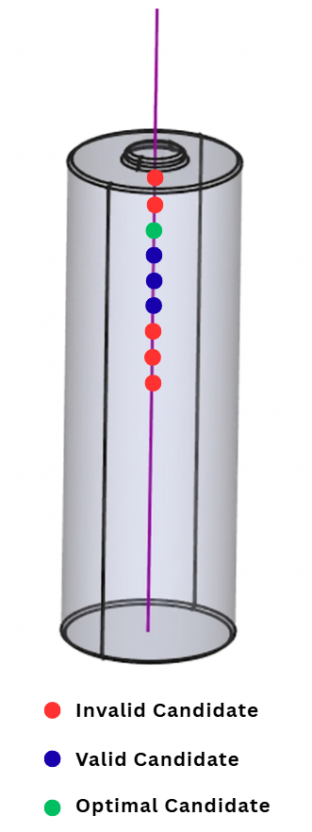
Grasp Candidate Generation
The algorithm to generate the candidates,
Defines a grasp region near the top surface
Samples points along the vertical axis
Generates multiple candidates.

Slide 14
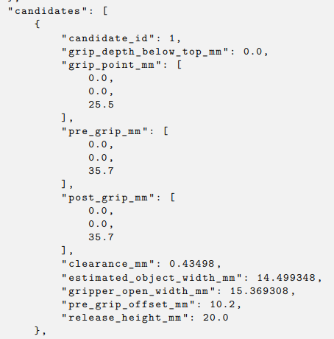
JSON Data Structure
All the generated grasping candidates and other parameters are stored in a JSON file.
Each candidate contains:
Position
Force
Motion parameters
This file acts as an interface between the Analytical model and Simulation.

Slide 15

Simulation Environment - MuJoCo
The candidates are then validated in MuJoCo
Python integration allows flexible development of custom control algorithms and parameter interfaces.
The robotic systems are represented by XML-based model files which contains the structure of the mechanical system, including rigid bodies, joints, actuators, and contact geometries.

Slide 16
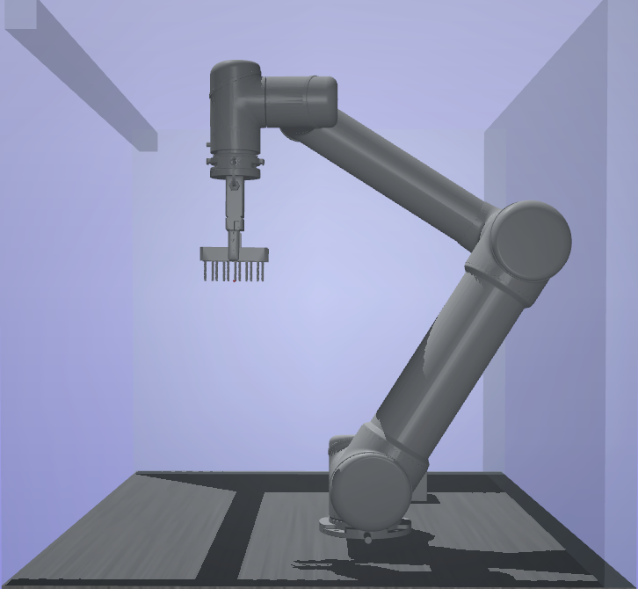
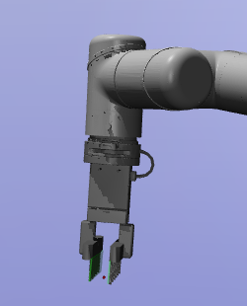
Robot and Gripper Modelling
The Robot is modelled as a set of rigid bodies connected by joints with constraints like joint limits, damping and actuator properties.
The Gripper is also represented by a pair of rigid bodies connected by prismatic joints which allows linear motion and are controlled by actuators..

Slide 17
Simulation Workflow
The Simulation begins by evaluating the Grasp candidates with a Python control script by applying collision and feasibility constraints and selects suitable candidates
Only one of those suitable candidates is selected as an optimal based on its minimal parameter values.
This candidate is again stored and fed as a JSON file to the MuJoCo physics engine to perform the final simulation.
JSON parameter File
Python Control Script
MuJoCo Physics Engine
Robot Simulation

Slide 18
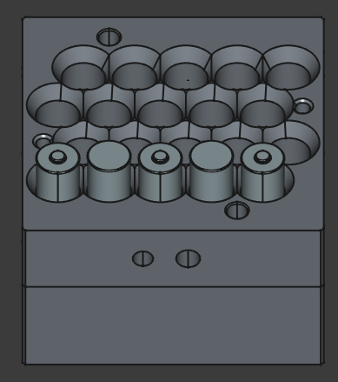
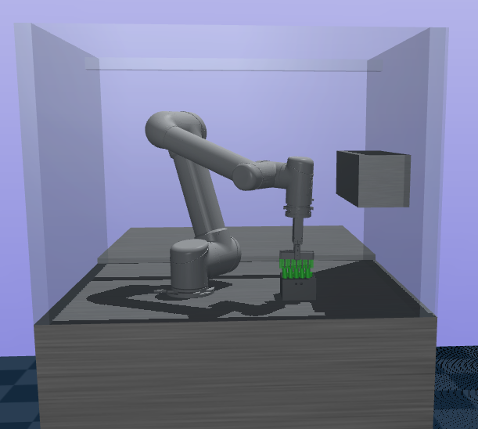
Experimental Setup
To validate the system:
Battery modules were used
CAD data was processed
Simulation was executed in MuJoCo
This setup reflects real industrial scenarios.
Battery Pack in Casing
Robot Picking up Battery Pack

Slide 19
Analysis of Results
Analytical parameters were sufficient
Grasp stability was maintained
Integration between modules worked seamlessly
RESULT

Slide 20
Limitations
Rigid body simplification
Neglect of dynamic effects
Assumption of constant friction

Slide 21
Summary
To summarize:
A complete automated pipeline was developed
Gripping parameters are computed analytically
Structured using PPR-SC
Validated using simulation

Slide 22
Future work
Vision-based perception
Dynamic environments
More advanced contact models
Real robot implementation

Slide 23
Thank you

